Slide 1
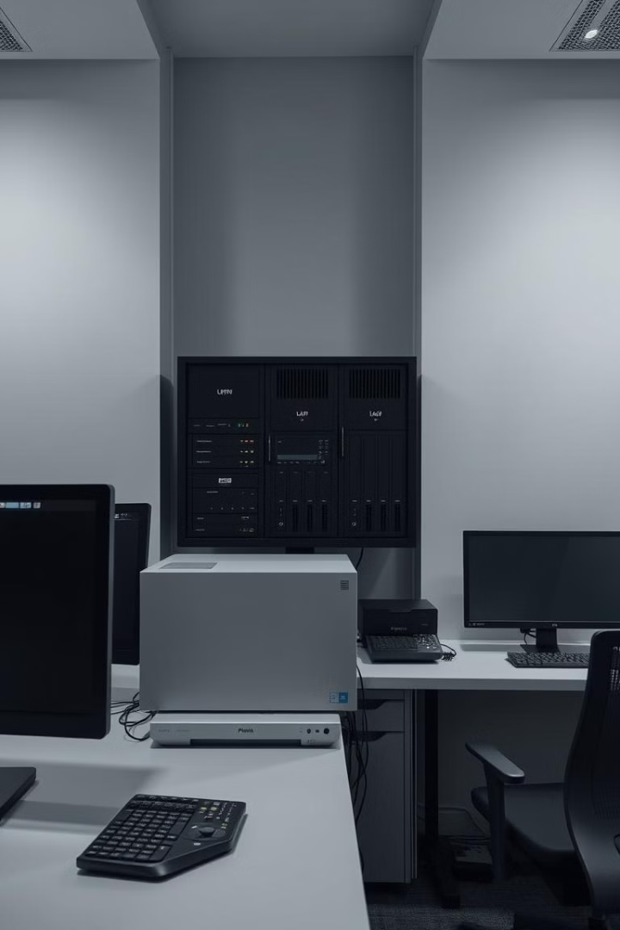
Introduction to Local Area Networks (LANs)
A LAN connects devices in a limited area. It enables resource sharing and communication. It also supports centralized administration. The global WLAN market is projected to reach $97.6 billion by 2027.

Slide 2
Meet The Course Teacher
Dr. Md. Tofael Ahmed
Associate Professor
Department of ICT
Comilla University

Slide 3
Meet The Team
Omma Habiba Nusrat ID : 12409026 | Mst. Urmi Begum ID : 12409027 | Md. Yasin Sarker ID : 12409028 | Hasibul Islam ID : 12409031
Tonmoy Chowdhury ID : 12409032 | MD. Razinur Rahman Razin ID : 12409033 | Mahadi Hasan Fardin ID : 12409034 | Humaira Mahbuba Khan Prova ID : 12409036

Slide 4




Core Components of a LAN
NICs
Switches
Routers
Network Interface Cards: Connects devices to the network.
Forwards data and segments the network.
Connects LANs to external networks.

Slide 5

LAN Topologies: Visualizing Network Structures
Bus
Star
Linear, single cable, easy setup.
Central hub, easy management.
Ring
Mesh
Data in a loop, high performance.
Redundant, high reliability.

Slide 6
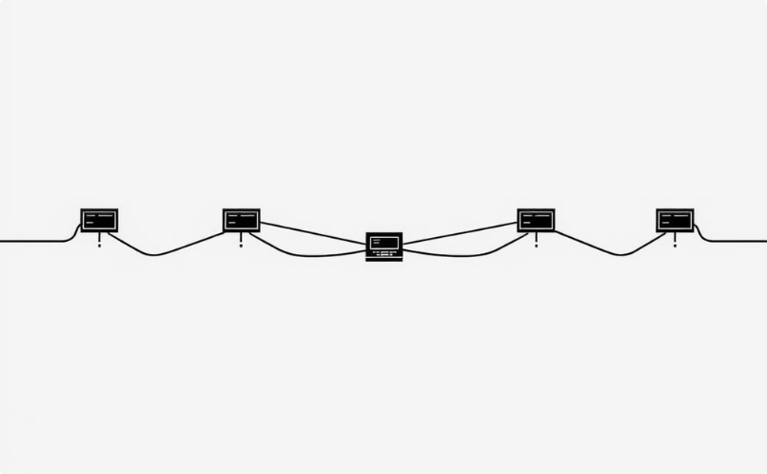
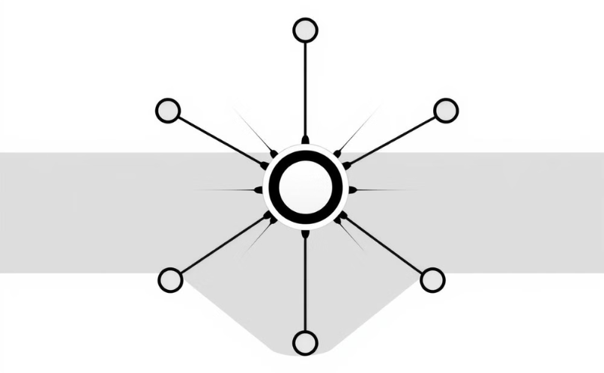
LAN Topology
Bus
Star
A bus topology is a way of connecting computers and devices in a network using a single main cable, called a bus. All devices are linked to this cable, and data travels in both directions along it.
A star topology is a type of network setup where all computers and devices are connected to a central device, usually a switch or hub. This central device manages communication between the connected devices.

Slide 7
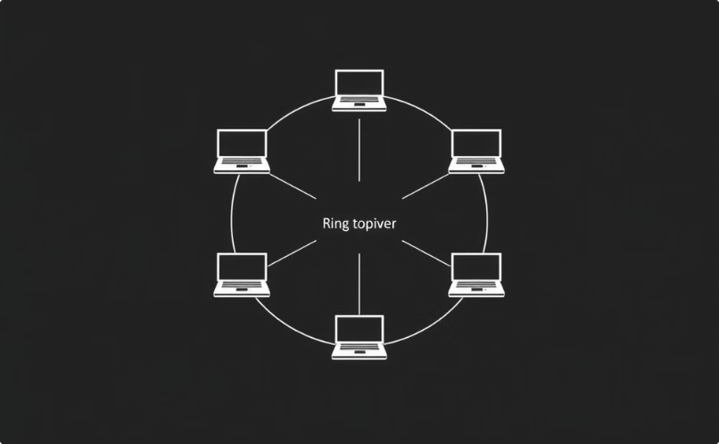

LAN Topology
Ring
Mesh
A ring topology is a network setup where each device is connected to exactly two other devices, forming a circular path. Data travels in one direction (or sometimes both in a dual-ring setup) until it reaches its destination.
A mesh topology is a network setup where every device is directly connected to every other device, creating multiple paths for data to travel.

Slide 8

LAN Topology: The Language of Networks
Ethernet
1
Dominant protocol for wired LANs.
2
Wi-Fi
Standard for wireless LANs.
TCP/IP
3
Communication over networks.

Slide 9
Advantages and Disadvantages of LANs
Advantages
Disadvantages
Resource sharing.
Limited area.
Centralized admin.
Security risks.
Enhanced communication.
Maintenance.

Slide 10
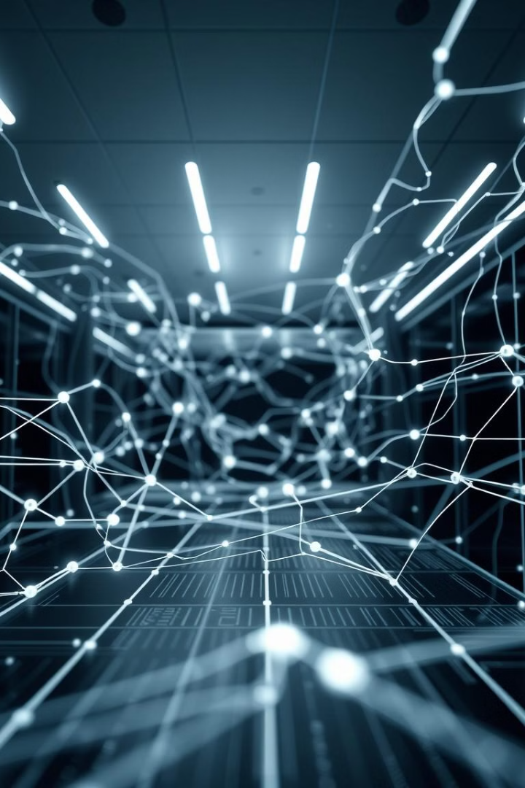
Conclusion: The Enduring Importance of LANs
LANs play a critical role in modern computing. Key aspects include components, topologies, and protocols. Future trends include cloud-managed networks. Contact us for further consultation and Q&A.

